Slide 1
FACE MASK DETECTION
Kunal Kumar Sahoo
XII-A

Slide 2
Objective To identify the person on image/video stream wearing face mask with the help of computer vision and deep learning algorithm.
Approach 1.Train Deep learning model (MobileNetV2) 2.Apply mask detector over images / live video stream

Slide 3
BASIC CONCEPT USED
Machine Learning : This is a new segment in programming where a neural network is developed inside the computer in which numerical patterns in forms of arrays are generated from input data and output data.
Neural architecture search (NAS) : It is a technique for automating the design of artificial neural networks (ANN), a widely used model in the field of machine learning. NAS has been used to design networks that are on par or outperform hand-designed architectures.

Slide 4
RESOURCES
Python : Python is an interpreted, high-level and general-purpose programming language.
Tensorflow : TensorFlow is a free and open-source software library for machine learning. It can be used across a range of tasks but has a particular focus on training and inference of deep neural networks. Tensorflow is a symbolic math library based on dataflow and differentiable programming.
Keras : Keras is an open-source library that provides a Python interface for artificial neural networks. Keras acts as an interface for the TensorFlow library.

Slide 5
RESOURCES
SKLearn : Scikit-learn is a free software machine learning library for the Python programming language. It features various classification, regression and clustering algorithms including support vector machines etc.
Imutils : A series of convenience functions to make basic image processing functions such as translation, rotation, resizing, skeletonization, displaying Matplotlib images, sorting contours, detecting edges, and much more easier with OpenCV .
OpenCV : OpenCV is a library of programming functions mainly aimed at real-time computer vision.

Slide 6
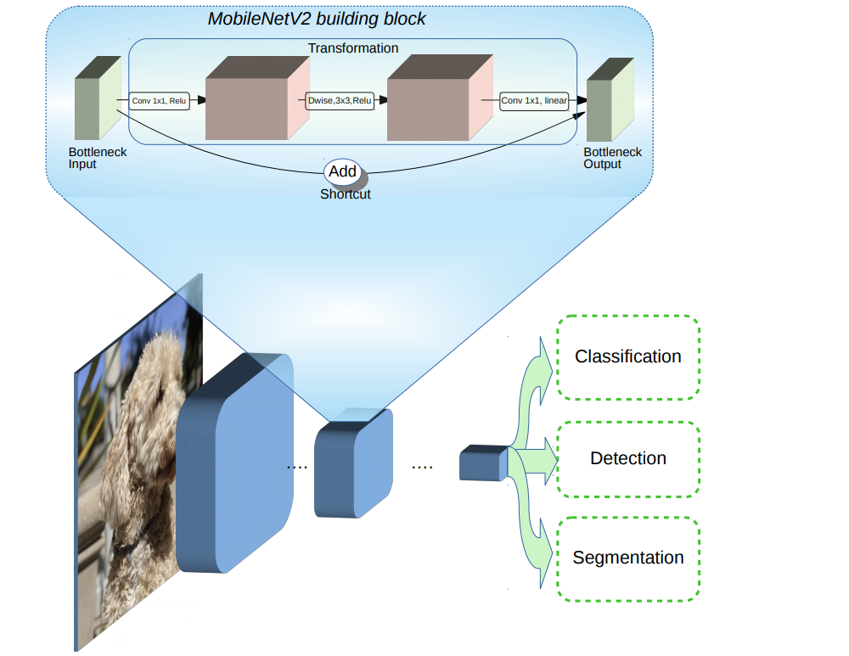
RESOURCES
MobileNetV2 :
It is a convolutional neural network architecture that seeks to perform well on mobile devices. It is based on an inverted residual structure where the residual connections are between the bottleneck layers. The intermediate expansion layer uses lightweight depth wise convolutions to filter features as a source of non-linearity. As a whole, the architecture of MobileNetV2 contains the initial fully convolution layer with 32 filters, followed by 19 residual bottleneck layers.

Slide 7
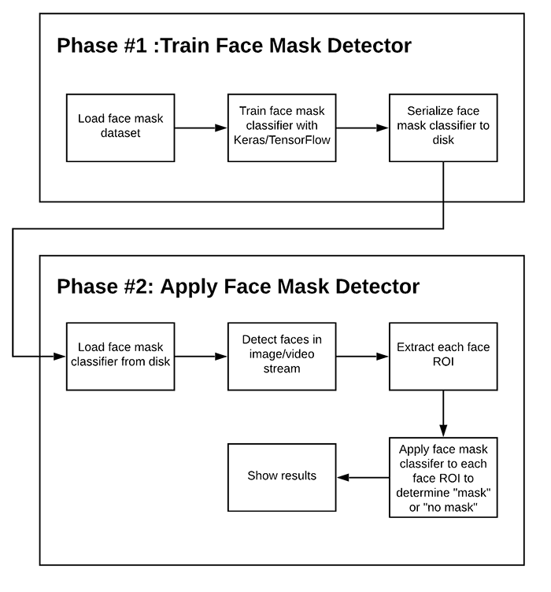
Two-phase face mask detector
Training: Here we’ll focus on loading our face mask detection dataset from disk, training a model (using Keras/TensorFlow) on this dataset, and then serializing the face mask detector to disk
Deployment: Once the face mask detector is trained, we can then move on to loading the mask detector, performing face detection, and then classifying each face as with_mask
or without_mask

Slide 8
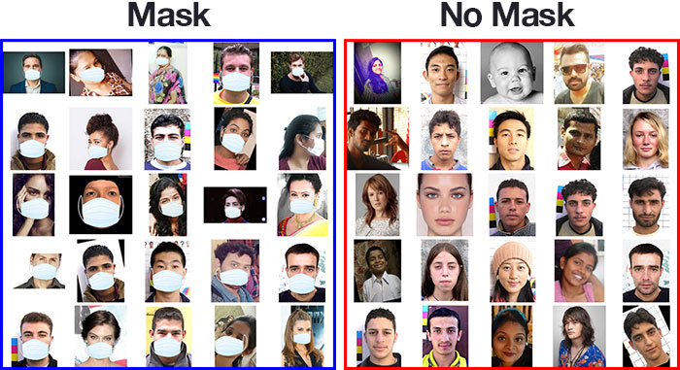
DATASETS

Slide 9
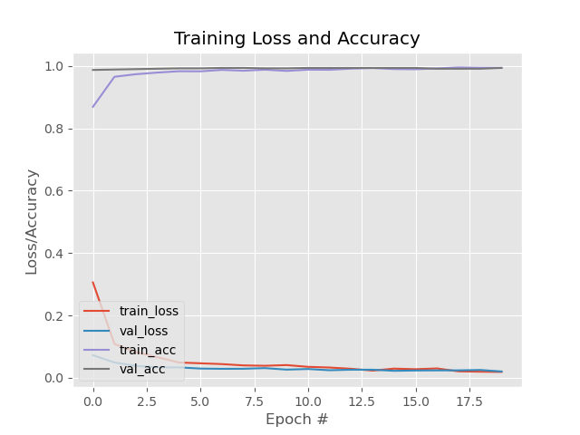
ANALYSIS OF MODEL TRAINING

Slide 10
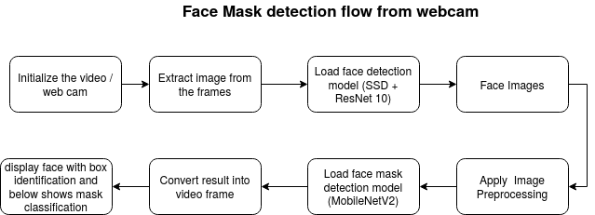

Slide 11
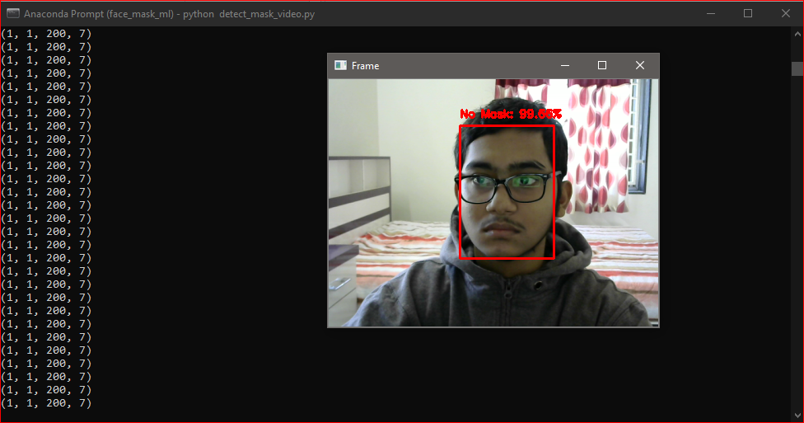
OUTPUT

Slide 12
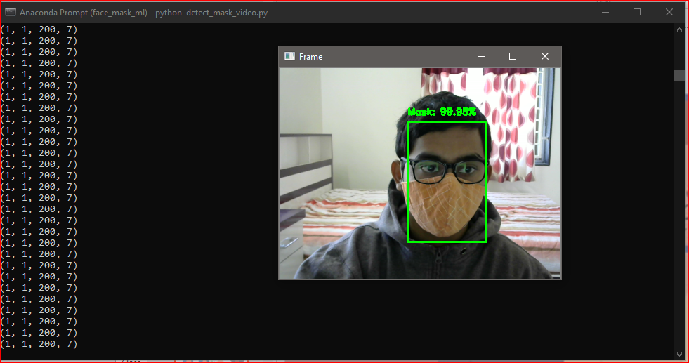
OUTPUT

Slide 13
APPLICATION
This program can be used as a subset program at institutes like malls, schools, airports etc. with their existing surveillance systems to differentiate between mask-wearers and no mask-wearers.
This can be also merged with the existing Aadhar Biometric Database to just automatically identify the non-mask wearers and penalizing them for compromising their and public health.
This program can also be implemented in a small micro-controller like Raspberry pi

Slide 14
FUTURE PLANS
To make a hybrid software where detection of faces for mask checking via video streaming and use the same data for further training happen simultaneously for continuous enhancement and robust performance.
To implement the YOLO algorithm in this program to store the biometric information of the targets and link it with their Aadhar databases.
To make the program efficient to take input from various video sources and make the identification process happen parallel.

Slide 15
THANK YOU

